Slide 1
Final Project Presentation: Hotel Reservations Analysis Jerry Fang

Slide 2
Background
In this project, I analyzed a hotel reservation dataset downloaded from Kaggle.
I think it is an interesting topic to find out some patterns on hotel reservation and cancellation information, which can help hotels manage their bookings better.
These problems are important for the hotel booking management:
The hotel can maximize its profit if it has as many rooms booked as possible.
It is inevitable that some guests need to cancel the bookings due to change in plans, scheduling conflicts, etc.
Hotels can slightly overbook their rooms to make sure rooms are utilized.
On the other hand, customers will be unhappy if the hotel is overbooked too much and needs to turn away guests.
Thus, a good prediction algorithm can help hotels decide how much to overbook and keep a nice balance between profit and customer satisfaction.
For this project, several machine learning algorithms are utilized for prediction.

Slide 3
Data
The Hotel Reservations data set contains booking information for hotels in 2017 and 2018, and includes information such as when booking was made, the number of adults, children, time of arrival, etc., and are all available on Kaggle.
Link to dataset: https://www.kaggle.com/datasets/ahsan81/hotel-reservations-classification-dataset
The dataset contains different types of information about the guests, timing, and the hotel rooms.
Information of the customer includes number of adults/children, special requests, parking, meal.
Timing information includes lead time, number of weekday/weekends, arrival month, etc.
The hotel room information includes hotel price, meal plan and room type.
There are a total of 36275 entries (data rows) and 19 columns in the dataset, reasonably good for machine learning algorithms.
I preprocessed the data by dropping the rows where at least one element is missing, and then used the data as is without any further preprocessing.
Categorical data are labeled into integers before the data is supplied to machine learning algorithms.
The customer id was dropped since it is irrelevant for booking status prediction.
The arrival year was also dropped when slicing the data since it will be different for future predictions.

Slide 4
Problem Statement
Hotel would like to maximize its profit
It is necessary to rent out as many room as possible
However, it should not make the guests unhappy due to room unavailable when the guest has reservation
So, it is important to have accurate prediction on booking cancellation
On the one hand, there are not too many canceled/unused rooms
On the other hand, Hotels don’t need to turn guest away due to room availability (too many overbook)

Slide 5
Analysis – Visualization And Prediction
I did two kinds of Analysis
Visualization for pattern and machine learning for prediction
Visualization
I used python visualization and used the python libraries Matplotlib and Seaborn:
A bar plot is a good way to show the count of entries based on certain attributes.
Reservation count vs room type gives us an idea of which room type gets the most reservations.
Reservation count vs number of adults gives us an overview of the number of adults in the reservations.
The correlation map can help identify the correlation among features, such as number of children, number of weekend nights, and room type.
Data Processing Using Machine Learning for Prediction
The goal of data processing in this project is to train a machine learning model to accurately predict cancellation.
I used the following machine learning algorithms:
Gaussian Naïve Bayes
KNN
Logistic regression classifier,
etc.

Slide 6
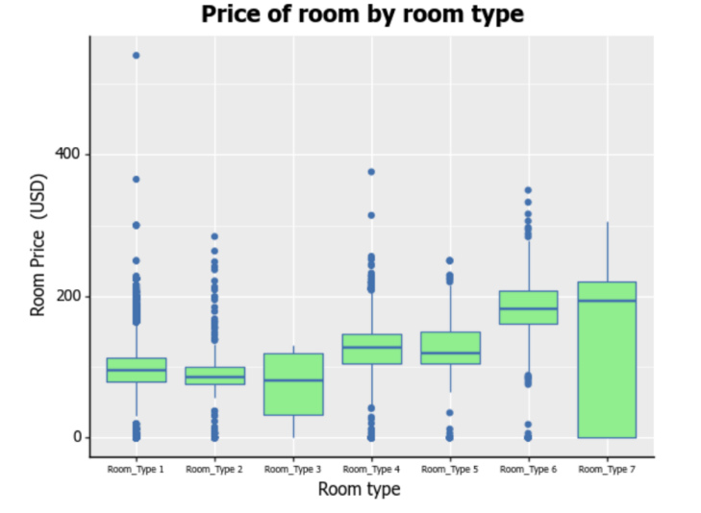
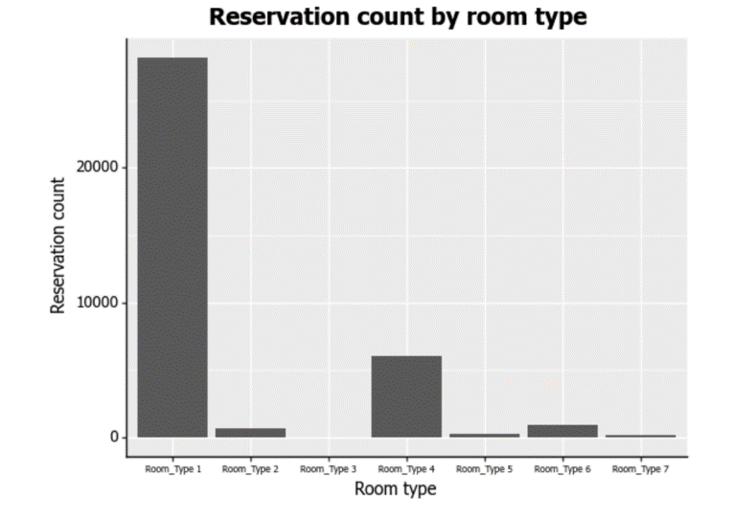
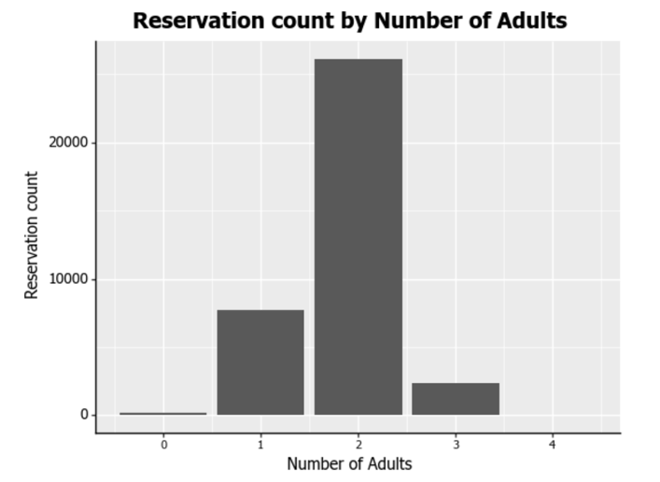
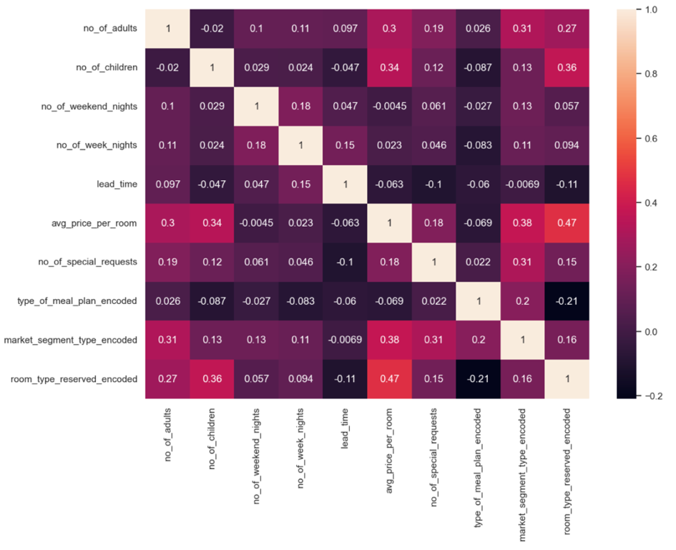
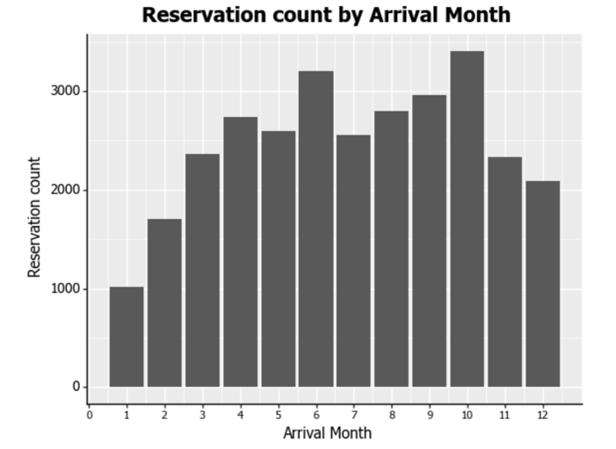
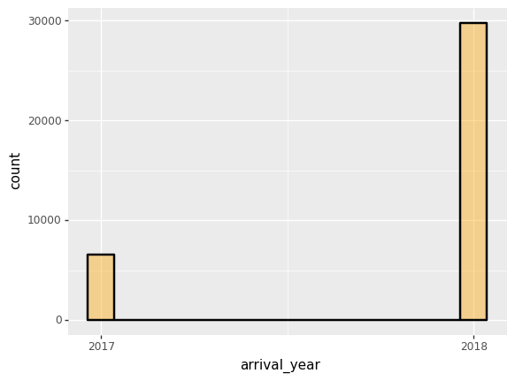
Results 1- Visualization
Some visualization help us understand the data and pattern
On average, Room type 7 Is more expensive, and Room Types 1, 2 and 3 are cheaper.
More individuals have made reservations for Room Type 1
More reservations made with 2 adults
More reservations in June and October
Reservations in the year 2018 than in 2017. 2017 data start from August
Heatmap: Correlation between the features

Slide 7
Results 2 – Prediction Using Machine Learning Algorithms
For the Data Processing portion of the project, I used several machine learning algorithms:
Gaussian Naïve Bayes
Accuracy: 0.773
K-Nearerst Neighbor (KNN) classifier
Built and trained model by creating the KNN classifier, and then fit to the data.
Tested and showed first 5 model predictions on the test data and found accuracy to be approximately 0.815.
When evaluating the logistic regression classifier model using model evaluation metrics, I found the accuracy, precision, and recall to be 0.788, 0.182, and 0.89 respectively.
The Receiver Operating Curve (ROC):
I found the AUC score is approximately 0.839, thus making it a reasonably good classifier.
Using the SVM, I found the accuracy, precision, and recall are respectively 0.799, 0.826, and 0.892.
Using the linear regression model, I found that the predicted y-values are somewhat close to the actual values (test values).
The Mean Absolute Error (MAE), Mean Squared Error (MSE), and Root Mean Squared Error (RMSE) are respectively 0.326, 0.151, and 0.389.
The results from the machine learning models show that the KNN classifier is the most accurate with an accuracy score of approximately 0.815.

Slide 8
Broader Impact
Helps hotel understand patterns
Pattern via Visualization –
Hotel room types and number of reservation for different types
Statistics of hotel room prices
Guest’s characteristics: Number of guests, number of weekend nights
Special requests, parking etc.
More…
Helps hotel manage booking and overbooking
Prediction on guest cancellation
Different machine learning algorithms are studies, they can all be helpful
Help maximize profit by manage booking better (Allow some overbook)
Reduce waste on unused hotel rooms – If hotels knows beforehand (prediction), the management can allow reasonable overbooking.
Better customer satisfaction
Not to overbook too much, so that the hotel can honor all hotel rooms reserved
This requires the prediction to be as accurate as possible
Hotel can team up with another hotel, incase too many rooms are sold, they can send some guests to the “friend hotel”
Additional Data to collect for other kind of applications
If hotel would like to offer discount for non cancellable reservation, how much discount should be offer?
Additional information may be helpful
For example, for the rooms that were cancelled, how many days before the arrival date were the rooms cancelled?
Are those cancelled rooms rebooked later by a different customer?
Location characteristics of the hotel (center city, or rural, is it close to attraction)
Information about big event dates (concerts, sports, trade shows etc.) could also be helpful.

Slide 9
The End!

